Slide 1
A Novel Dataset for Fake News Detection in Tamil Regional Language
T.T. Mirnalinee, Bhuvana Jayaraman, A. Anirudh, R. Jagadish and A. Karthik Raja
International workshop on Fake News Detection in Low-Resource Languages
(Regional-FAKE) on 24th & 25th November 2022
1st International conference on Speech and Language Technologies for Low-resource Languages (SPELLL - 2022)

Slide 2
Outline
Introduction
Objective
Literature Survey
Proposed System
Corpus Collection
Classifiers
Conclusion
References

Slide 3
Introduction
Tamil is one of the very few ancient languages that have survived the passage of time.
And yet even though a lot of pieces of literature are available for this language, not a lot of data is labeled.
With the Internet boom and digitization in all mediums, it is important to build classifiers for data analysis and prediction.
But the available labeled data is from little to none in each domain.
Misleading and distorted information will not only affect the individual but also impact on the public.

Slide 4
Objective
Distorted and misleading news travel quickly and cause damage to individuals and public.
Around 214% of increase in fake news was found in India, huge raise was observed during demonetization, state, central elections and Covid.
There is a need to classify fake news
No dedicated corpus was available in our regional language, Tamil that helps to build classifiers to detect the fake news
An automated system that checks the credibility of the news as real or fake is the dire need of the day
To give methods to extract news from new media and to annotate them as real and fake in the domains of Sports, Politics, Science, Entertainment and Miscellaneous

Slide 5
Literature Survey
The dataset [1], called Bend-The-Truth, had 900 manually collected fake and real news headlines in Urdu.
[2]The research work classifies offensive text in south Indian regional languages like Malayalam, Tamil.
Research works that label the intonation of words in a corpus have also been done [3]. This uses segmentation and clustering.
Various stemming algorithms were performed to identify various [4] types of words based on tenses.
Parts of Speech based word embedding for Tamil was proposed that used POS annotated corpus [5].
Sentence similarity is Tamil was done by combining the corpus based approach and knowledge based approaches [6].

Slide 6
Literature Survey
Named entity recognition for Tamil was proposed by extracting and classifying the NEs using word level Naive Bayes classifier [7].
Stemmer for Tamil language is proposed [8], where the authors removed n suffixes in different iterations.

Slide 7
Proposed System
Data Scraping : news headlines were scraped from various websites - BeautifulSoup was used.
Identification of websites, HTML structure was identified
Totally 5273 samples were collected
Headline and other metadata like the author's name, date of publication, and sometimes the tag.
Real news headlines were collected from reputed Indian regional and national
Newspapers and had separate sections for sports, politics, entertainment, and technology.
Hindu Tamil, Daily Thanthi

Slide 8
Proposed System
Certified fake news was collected from the fake news sections of reputed regional and national newspapers, as well as from certified online fact-checking websites namely politifact.com.
Regional and national News that are tagged as fake are from News18, One-India, Tamil-Samayam, Zee-News news headlines in Tamil.
Data Cleansing: Converted the manual labels into a homogeneous set namely sports, politics, entertainment, tech (science & business), and miscellaneous.
Fixed the spelling of the labels ;
Removed
additional characters;
duplicate column headings;
duplicated rows wherever required

Slide 9
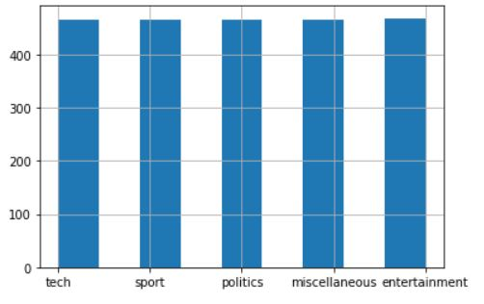
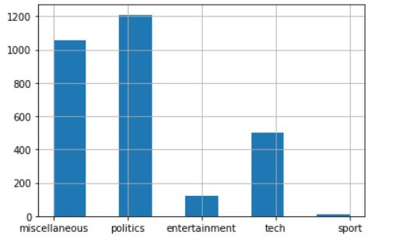
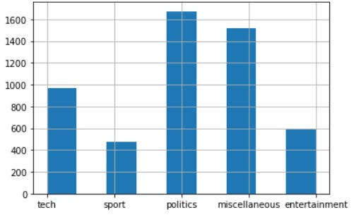
Exploratory Data Analysis (EDA)
The dataset was analyzed for the number of null values and duplicates
Total number of :5273,
real headlines:2324
Fake news :2949
Number of unique words:
real news :8518
fake news: 15897

Slide 10
Other Statistics

Slide 11
Classifiers & Results
Four machine learning models and one deep learning model were trained on the dataset as baseline classifiers
SVM, Logistic Regression, Naive Bayes, XG-Boost as the machine learning classifiers and a deep learning classifier, RNN with 2 LSTM layers

Slide 12
Conclusion
A novel text corpus consisting of real and fake news headlines in the Tamil regional language was created
Credible online sources for real and fake news were identified
Extracting headlines and meta-data from these websites
Cleansing the dataset
Performing exploratory data analysis on the cleansed data
Training baseline models on the dataset
Support Vector Machine, with an accuracy of 87.85%
In the future, state-of-the-art machine learning models can be built for this

Slide 13
References
Amjad, M., Sidorov, G., Zhila, A., G´omez-Adorno, H., Voronkov, I., Gelbukh, A.: “bend the truth”: Benchmark dataset for fake news detection in urdu language and its evaluation. Journal of Intelligent & Fuzzy Systems 39(2), 2457–2469 (2020)
Jayaraman, B., Mirnalinee T., T., Anandan, K.R., Kumar, A.S., Anand, A.: Offensive text prediction using machine learning and deep learning approaches. In: FIRE (2021) 13.
Narayana, L., Ramakrishnan, A.: Defining syllables and their stress labels in mile Tamil TTS corpus. In: Workshop in Image and Signal Processing (WISP-2007) (2007).
Thangarasu, M., Manavalan, R.: Stemmers for tamil language: performance analysis. arXiv preprint arXiv:1310.0754 (2013)
Thavareesan, S., Mahesan, S.: Word embedding-based part of speech tagging in tamil texts. In: 2020 IEEE 15th International Conference on Industrial and Information Systems (ICIIS). pp. 478–482. IEEE (2020).
Selvarasa, A., Thirunavukkarasu, N., Rajendran, N., Yogalingam, C., Ranathunga, S., Dias, G.: Short tamil sentence similarity calculation using knowledge-based and corpus-based similarity measures. In: 2017 Moratuwa Engineering Research Conference (MERCon). pp. 443–448. IEEE (2017)

Slide 14
References
Srinivasan, R., Subalalitha, C.: Automated named entity recognition from tamil documents. In: 2019 IEEE 1st International Conference on Energy, Systems and Information Processing (ICESIP). pp. 1–5. IEEE (2019)
Ramachandran, V.A., Krishnamurthi, I.: An iterative stemmer for tamil language. In: Asian Conference on Intelligent Information and Database Systems. pp. 197– 205. Springer (2012)

